Slide 1
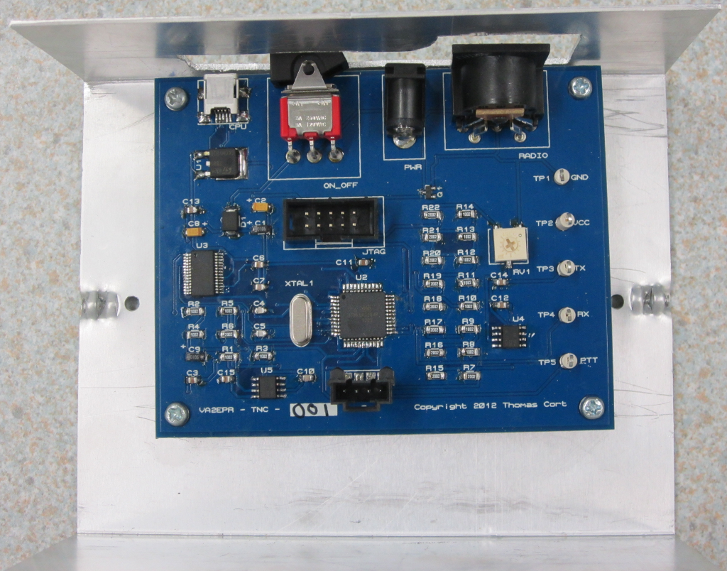
Terminal Node Controller Final Project
Thomas Cort

Slide 2
Motivation
Learning about digital communications.
Building a device that I will use.
Sharing my design and software with others.
Improving on existing technology.
Passing the course and graduating.

Slide 3
Outline
Introduction
Background Information
High Level Block Diagram
Schematic
Layout
Assembled Devices
PC Software
Challenges
Future Directions
Questions

Slide 4
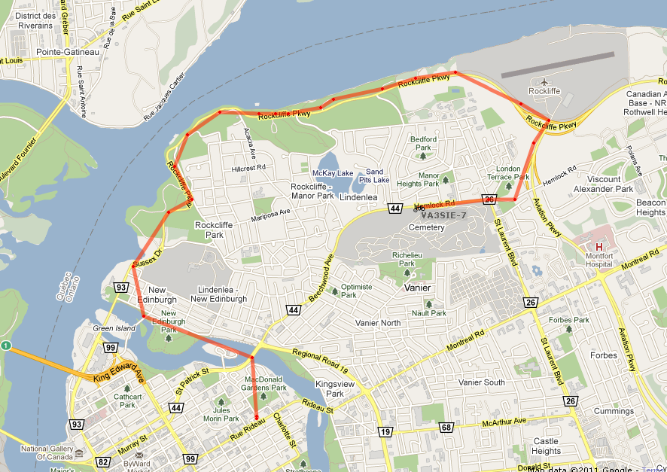
Introduction
Position Tracking System

Slide 5
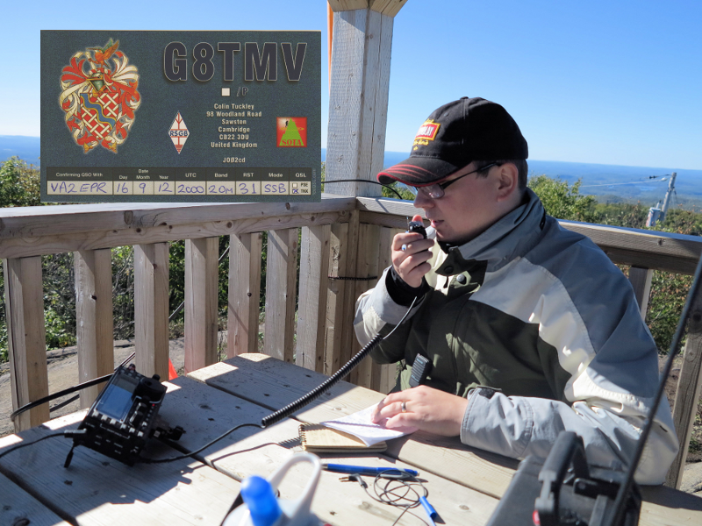
Background Information
Amateur Radio

Slide 6
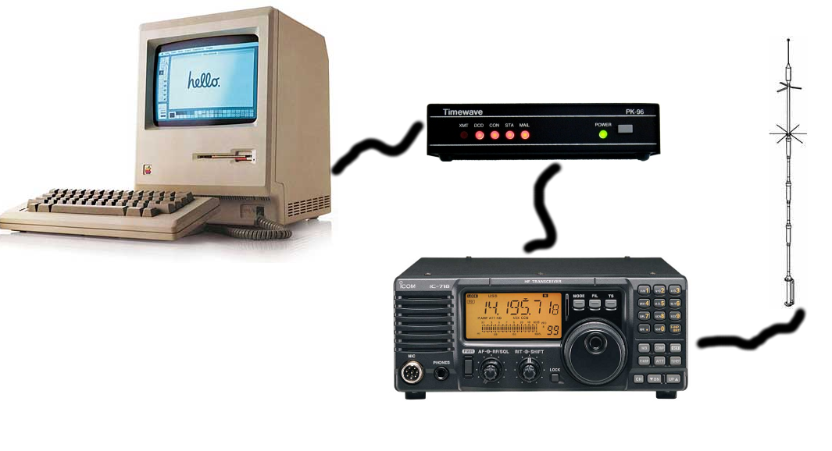
Background Information
Packet Radio Terminal Node Controllers

Slide 7
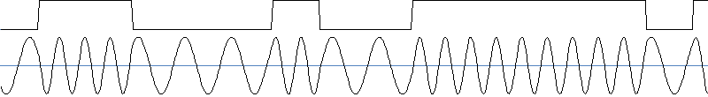
Background Information
Packet Radio Networks for Position Reporting
Network – APRS
Data link – AX.25
Physical – Bell 202 (1200 Baud AFSK NRZI)

Slide 8
Goals
Modern
Reliable
Low-cost
Easy to use
Open design
Small form factor
Portable version

Slide 9
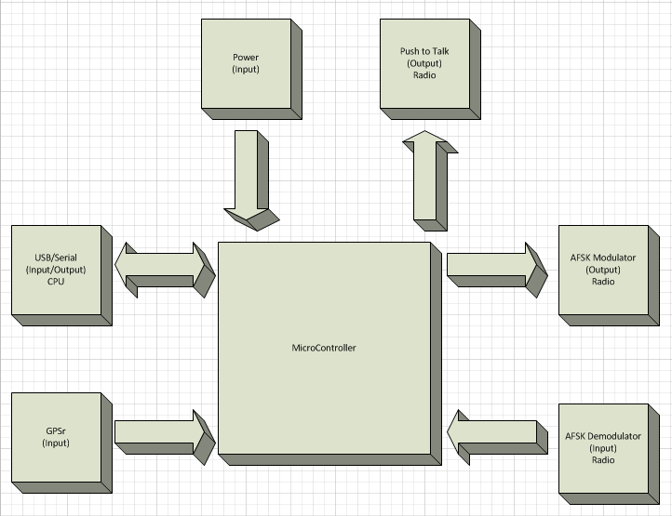
High Level Block Diagram

Slide 10
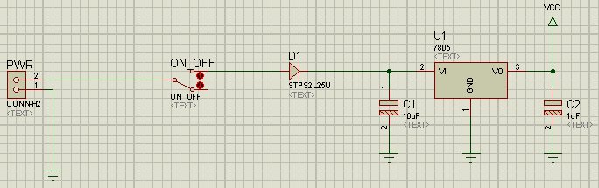
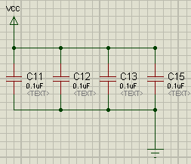
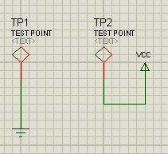
Schematic

Slide 11
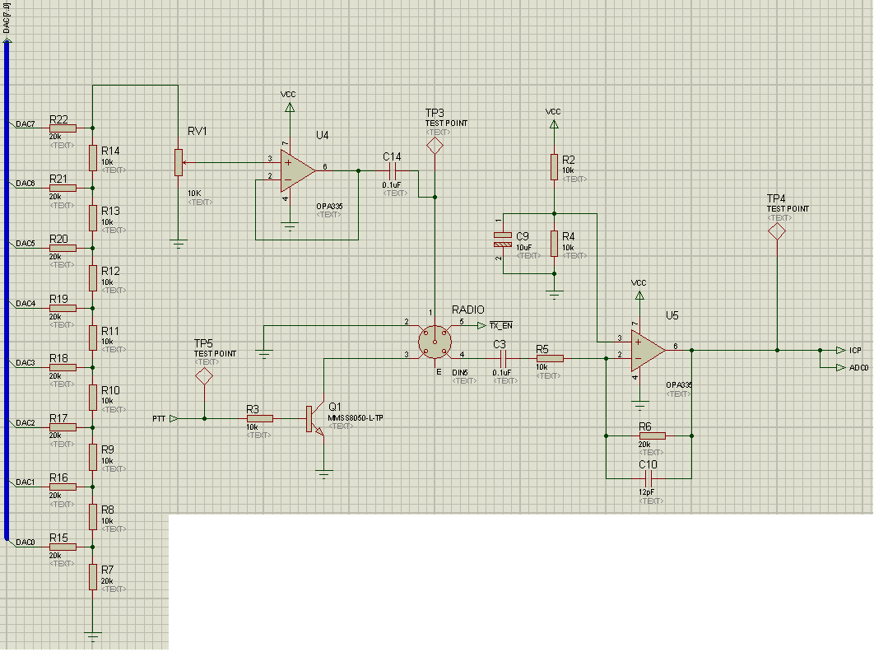
Schematic

Slide 12
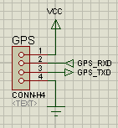
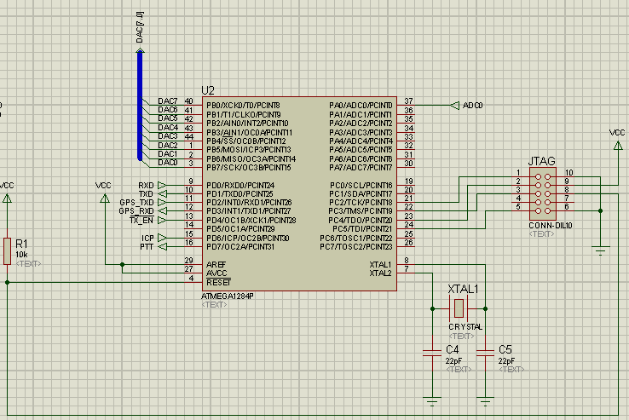
Schematic

Slide 13
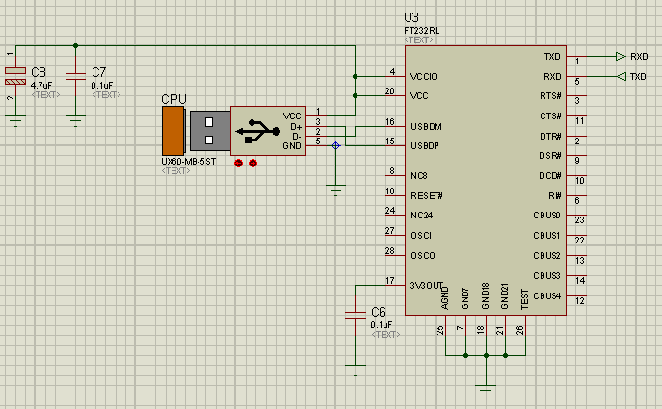
Schematic

Slide 14
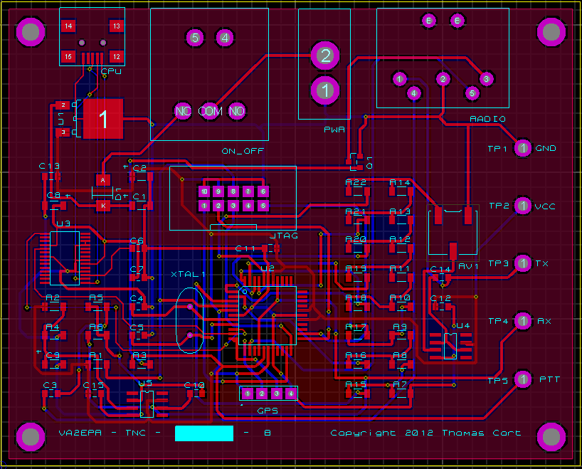
Layout

Slide 15
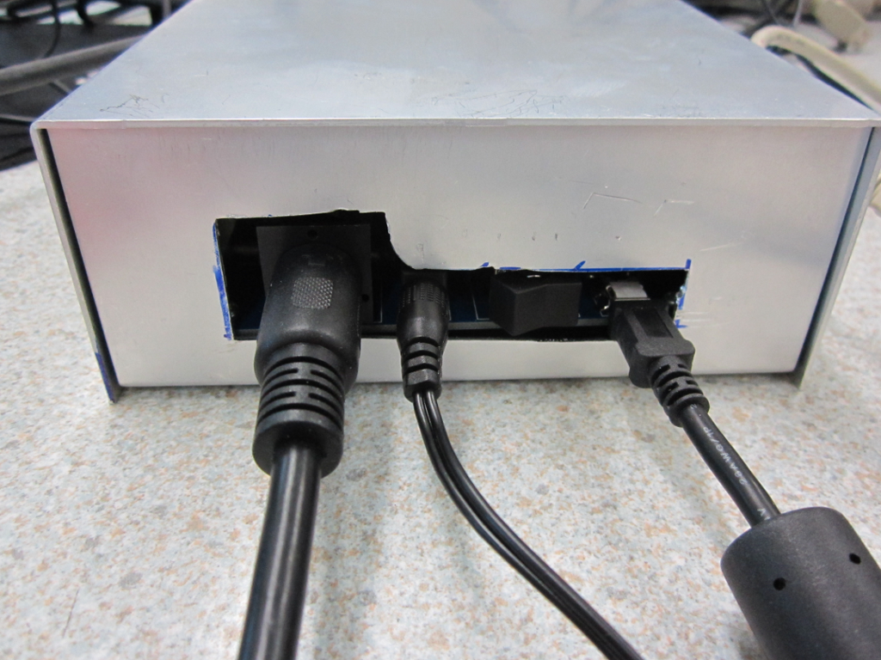
Assembled Project

Slide 16
Hardware Specification
Property | Value
Dimensions | 5.500” W x 2.250” H x 4.500” D
Weight | 250g
Input Power | DC 7.5V to 16V, 75 mA Typical (1.5A Max)
RX Audio | 0.1Vpp Min, 1Vpp Ideal, 5.5Vpp Max
TX Audio | Up to 5Vpp
Ports | 2.1mm Barrel (Power Input), DIN5 (Radio), USB Mini B (Computer), JTAG (Debug/Program)
Modulation | AFSK NRZI with 1200 Hz & 2200 Hz tones (half-duplex).
Maximum Transmission Unit (MTU) | 8KB (TX), Unlimited (RX)
Processor | ATMega1284p running at 14.7456 MHz
Host Operating System Requirements | Windows 98 or greater, Linux, Mac OS 8 or greater, Android, or Windows CE.NET 4.2 or greater.
Recommended Host Software | VA2EPR TNC v1.0
Operating Temperature Range | 0C to 70C
Standards Implemented in Firmware | Bell 202, KISS, NMEA, CSMA/CA
Compliance | This device is a prototype and hasn’t been formally tested for compliance with any standards (e.g. FCC Class B, UL, CE, etc.).

Slide 17
Firmware
APRS
AFSK
EEPROM
CSMA
NMEA
GPS
UART

Slide 18
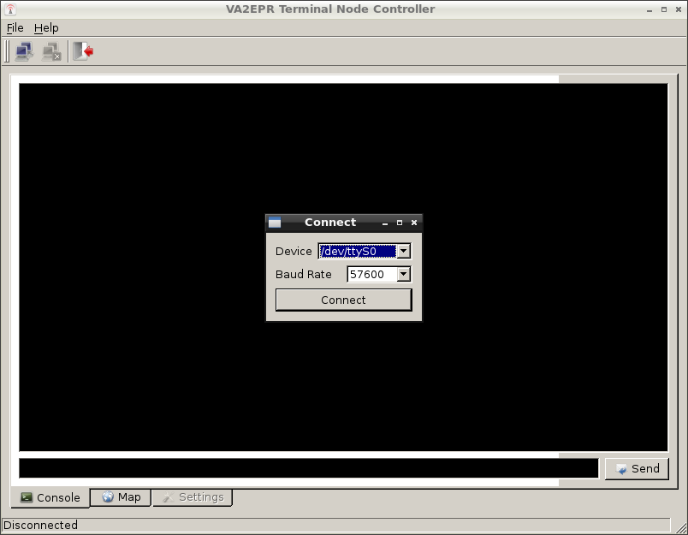
PC Software – Terminal

Slide 19
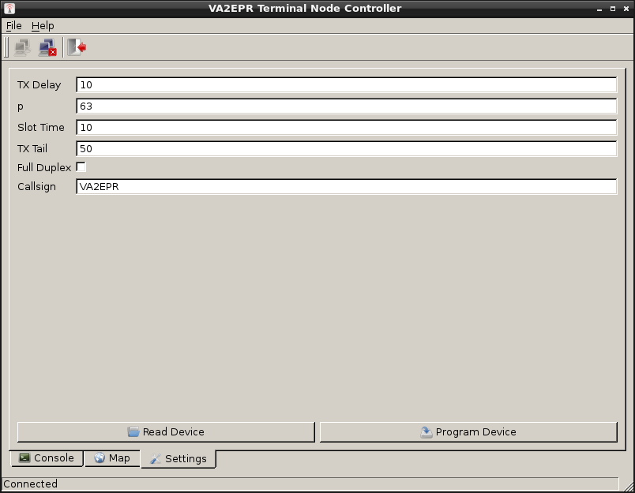
PC Software - Configuration

Slide 20
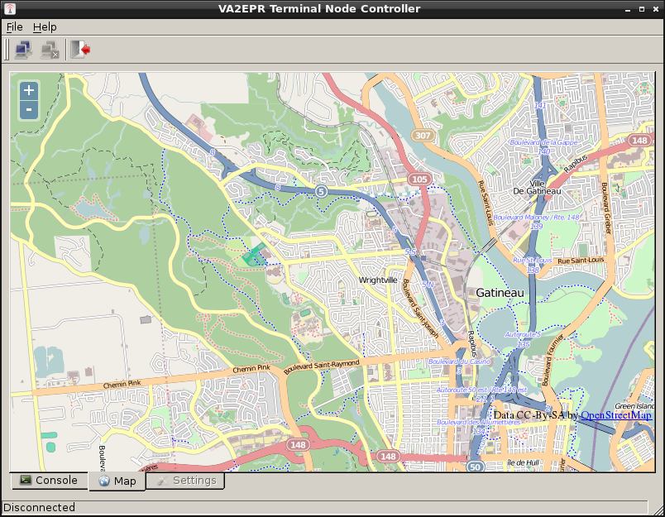
PC Software - Map

Slide 21
Biggest Challenges
Hardware prototyping with different parts
Prototype was through hole and final was surface mount.
Different parts for prototype and final hardware.
Custom cables took several classes to build correctly.
Modding the enclosures.
Without any type of metal cutter, I had to drill and file.
Debugging AFSK demodulation.
Can’t step through – has to be real time to work.
Sending too much info to UART delays decoding (skewing).
Have to really understand how your code is executing.

Slide 22
Future Modifications
Visual On/Off indicator (LED?)
External JTAG connector for easy access.
Faster CPU (arm?) or dual CPU (1 for TX, 1 for RX)
Use a transistor as a switch to turn the gps on and off
Redo schematic & pcb with open source CAD program.
Alternative radio interface connector (not DIN5).
DAC pins DAC0 on PB0 … DAC7 on PB7
Use an OpAmp package that has 2 op amps per package
Redesign as a BeagleBone cape (expansion board).

Slide 23
The End
Questions?

